Slide 1
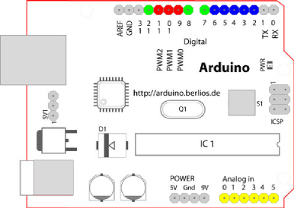
Car Controller Module
1. Arduino Pin
Pin #2 : Unlock Switch for door
(Input) (5V-->5V)
Pin #3 : Lock Switch for door
(Input) (5V-->5V)
Pin #4 : Ignition_check
(Input) (12V-->5V)
Pin #5 : Door_Status
(Input) (12V-->5V)
Pin #6 : Alarm Trigger
(Input) (5V-->5V)
Pin #7 : Ignition_check
(Output) (5V-->5V)
Pin #8 : Door_Status
(Output) (5V-->5V)
Pin #10: Horn
(Output) (5V-->12V)
Pin #11: Light
(Output) (5V-->12V)
Pin #12: Door Lock
(Output) (5V-->12V)
Pin #13: Door Unlock
(Output) (5V-->12V)
Figure 1. Arduino Duemilanove

Slide 2
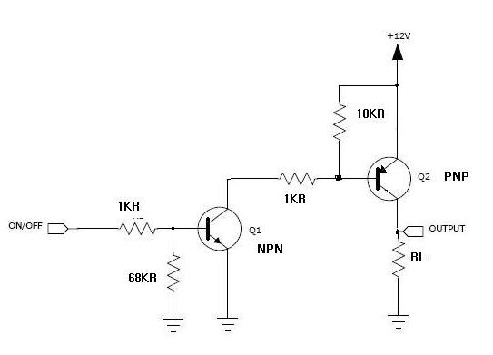
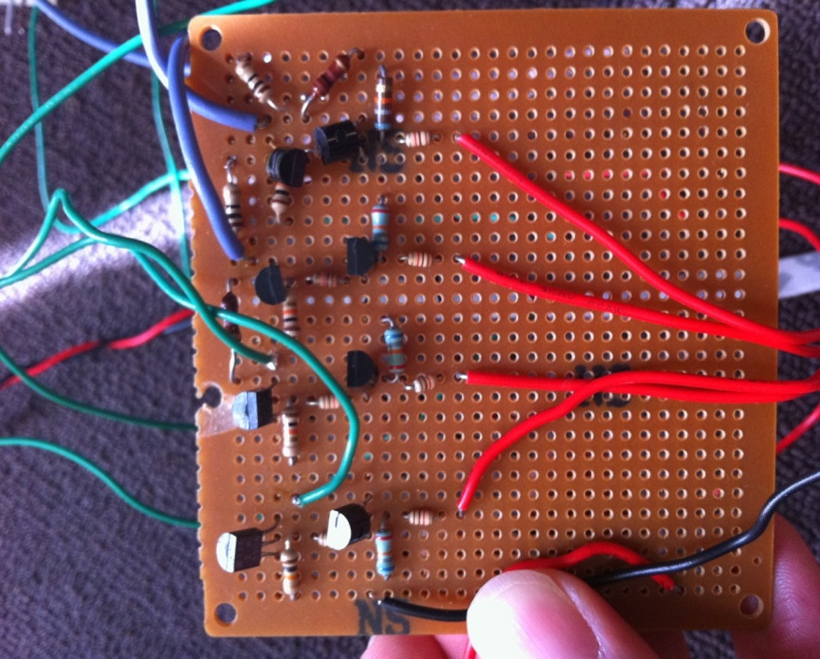
Car Controller Module
2. 5V to 12V NPN & PNP Amplifier
Figure 2. Schematic of Amplifier
Figure 3. BJT AMP Module

Slide 3

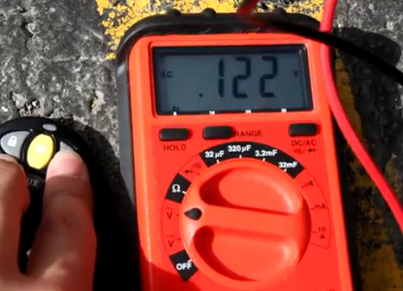
Car Controller Module
3. Door Lock/Unlcok Demonstration
Figure 4. Connect Voltage meter to Door
Figure 5. Door Lock/Unlock Module

Slide 4
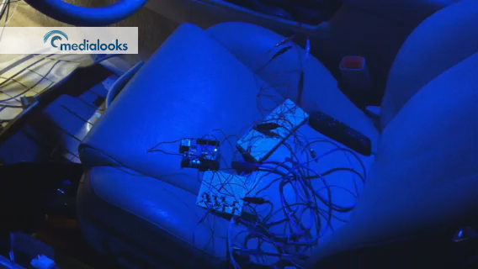
Car Controller Module
4. Head Light Demonstration
Figure 6. Head Light Module

Slide 5
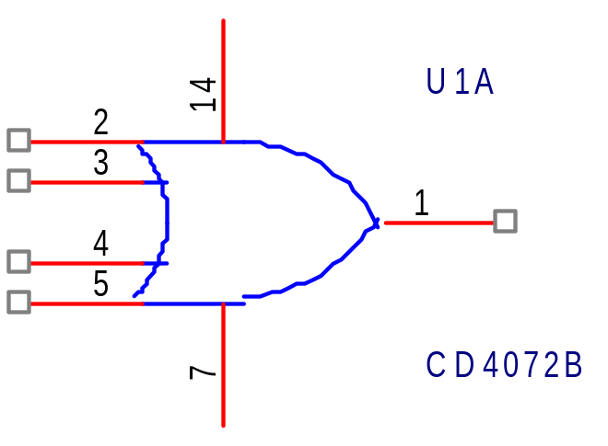
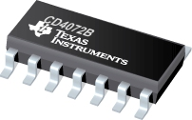
Car Controller Module
5-1. To Do List
Door Status Module
Figure 7. 4-Input Or Gate CD4072B

Slide 6
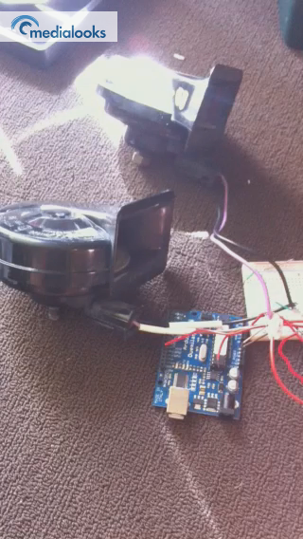
Car Controller Module
5-2. To Do List
2. Horn Controller
Figure 8. Horn Test with Arduino

Slide 7
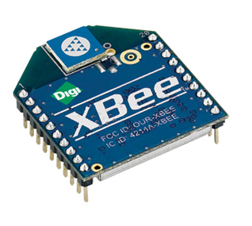
Car Controller Module
5-3. To Do List
3. X-bee
Figure 9. Xbee RF Module

